Slide 1
Social & Economic Considerations
Presenter Name
Location

Slide 2
Objectives
Describe common challenges to SHMS adoption and transition.
Summarize economic effects of SHMS through partial budgets and case studies.

Slide 3
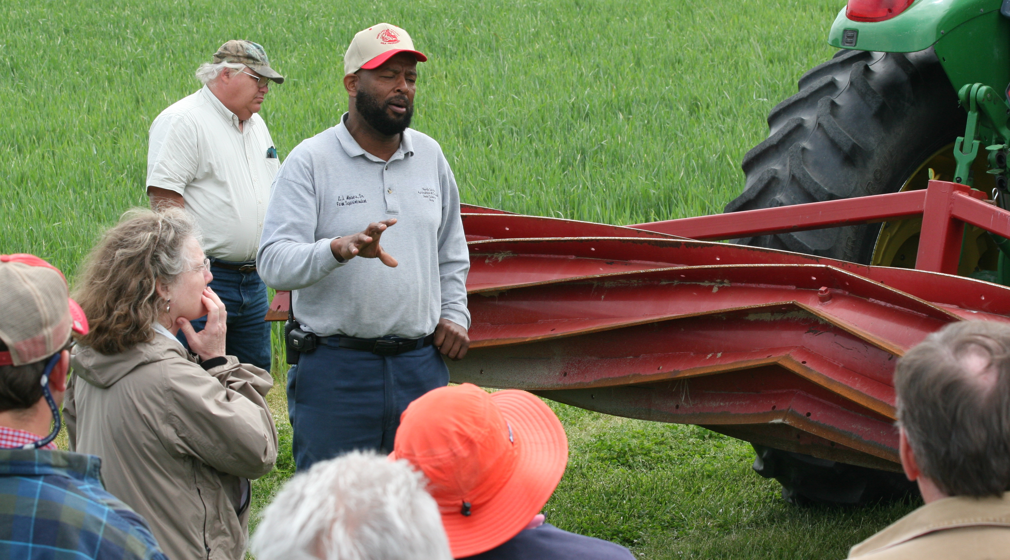
Adopting Soil Health Practices
“Requires not only an understanding of the physical resource data but also social data.”
Awareness a understanding key human social & economic considerations can assist with implementation & long term adoption
What is the current perception of soil health in your region?
What keeps people from implementing & how have others overcome these obstacles?
Source: The Adoption and Diffusion of Conservation Technologies, People, Partnerships, and Communications, Issue 7, Updated June 2005
Notes:
One current perception: Most people initially agree to do no-till because of the potential to reduce erosion. Change picture to localized conditions

Slide 4
Adoption
Behavior associated with an individual's or group’s decision on whether or not to accept new ideas, practices or products
Technology Transfer
The process by which the adoption of a new idea, practice, or product spreads throughout a group, community or society
How To Impact Change
Notes:
Adoption-Diffusion or Adoption-Tech Transfer is a way of looking at what influences a producer’s decision to adopt an ag practice.

Slide 5
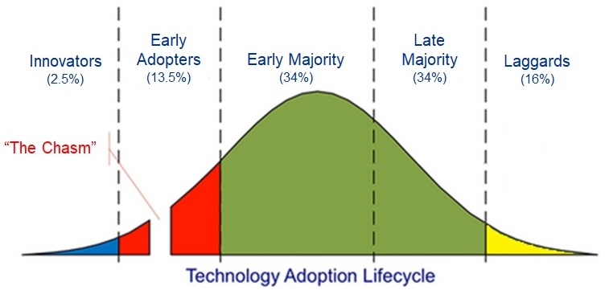
Adoption Categories

Slide 6
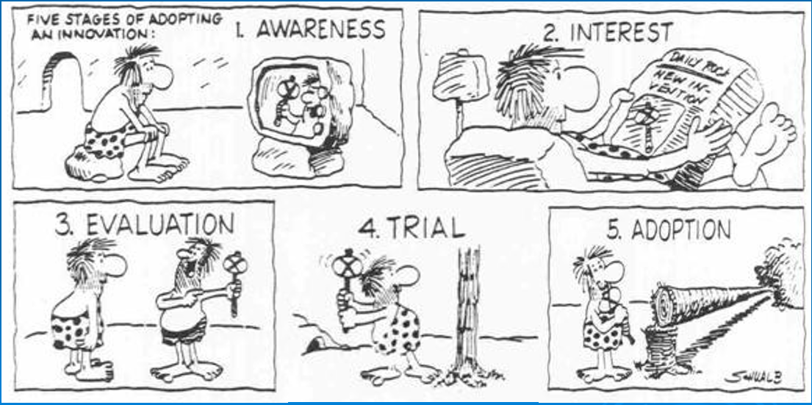
Individual stages of adoption
The producer can return to any one of these stages at any time during the adoption process
Rogers and Shoemaker, 1971
Notes:
REFER TO THE HANDOUT
Awareness—producer becomes “aware” of new technology through media, conferences etc
Interest—the producer wants more information about the practice and how it will fit into their current operation. They may read up on it, look for a consultant etc.
Evaluation—Still thinking about the new technology the producer makes a mental application of the practice to a specific situation on his operation. They will ask question such as can I apply this? What will I gain? Will the gain be worth the change to what I am currently doing? What is the downside?
Trial—the producer concludes that the practice has potential and will try it. Small scale-with check strips to see how it compares. Or they will visit others that have the new technology on their current operation or university.
Adoption—a producer decides that the practice is a good one and will fully incorporate in to the operation
Adaptation—customization of the technology; making tweaks.
What do we do if the producer decides to reject the new technology?
This process is not necessarily linear, sometimes they can go from an early stage to a late stage, or revert back to an earlier stage.

Slide 7
Knowledge check – poll question
Notes:
For virtual presentations, show this slide and then have host bring in the poll question (contained on the next slide).

Slide 8
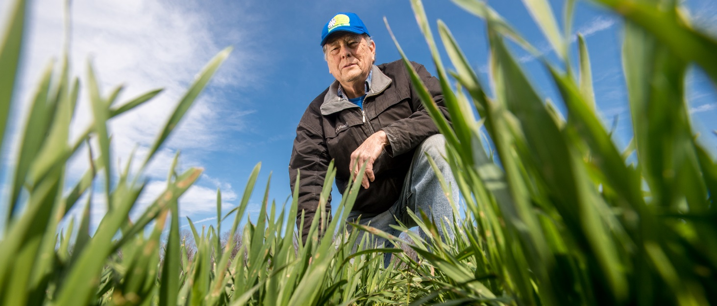
Stages of adoption
As a planner where do you fit in these stages?
  In all of them
At what stage can you fail the landowner?
  Any stage: by lack of follow through or interest after the initial contact at the awareness stage or any time when the producer seeks assistance.
Remsberg, SARE
Notes:
You fit in at each and every stage
From presenting the different soil health demos for awareness to getting more interest from your newsletters, emails, presentations to assisting with the evaluation, trial, adoption and adaptation.

Slide 9
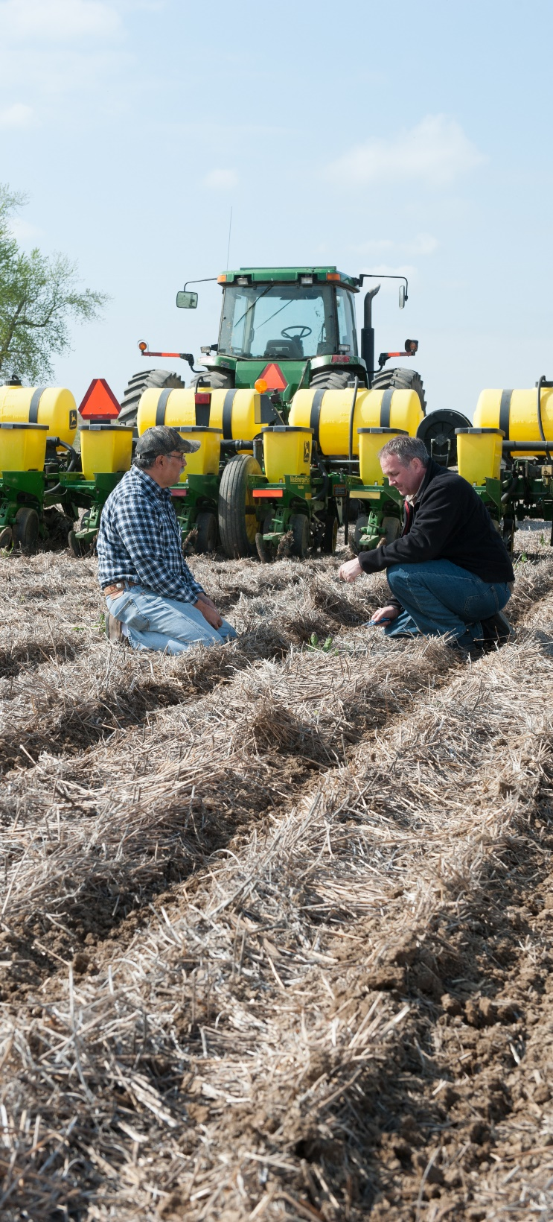
What are Some Obstacles to Soil Health Adoption?
Lack of technical information
Lack of community support (socially or economically)
Inter-Agency organizational barriers
Landlord/tenant relationships
Economic
  Installation cost
  Management capability
  Risk aversion
Remsberg, SARE
Notes:
Ask the class to brainstorm possible solutions to overcome these barriers. These can be recorded on a board or flipchart—

Slide 10
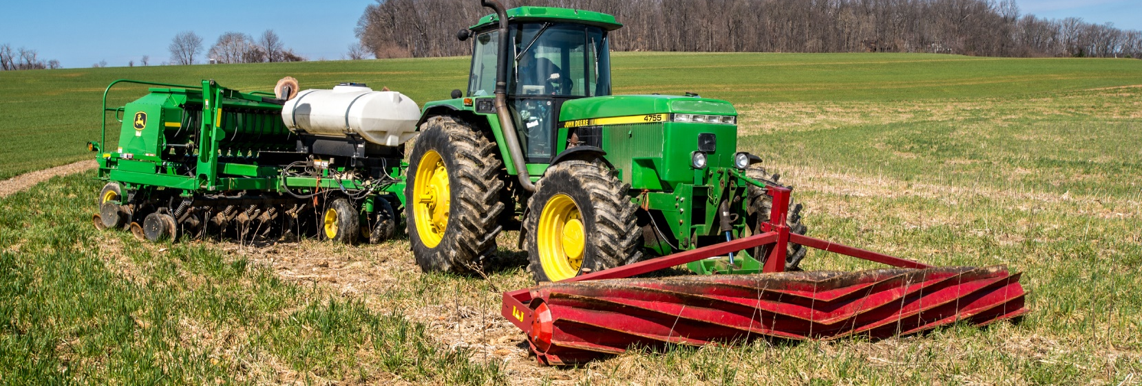
Economic Considerations
How many producers have used these arguments to not improve soil health?
  It costs too much
  Lack of time to seed cover crops
  Uses too much water
  There is a yield drag
  Don’t want any extra weeds in my field
Remsberg, SARE
Notes:
Ask them: What can do you do to address these issues and turn the conversation around?
The Merit or Myth video series addresses a lot of the common arguments that producers raise for not implementing soil health practices.

Slide 11
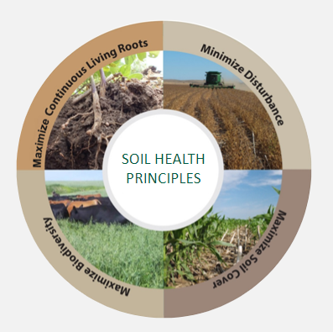
Improved Soil Function can Lead to Benefits for the Producer
Potential Benefits
  Reduced Erosion
  Increased Soil Organic Matter
  Increased Nutrient Cycling
  Increased Drought Resilience
  More Available Water
  Improved Filtering and Buffering
  Reduced Pest and Disease incidence
  Reduced Risk
Notes:
Improving soil functions; nutrient cycling, regulating water, filtering and buffering of pollutants, a stable platform to farm and improve soil biodiversity, leads to environmental benefits.
Discuss each briefly, give example:
Each of these soil functions can be tied to economics! Take some time to describe the impact on economics with each soil function/benefit listed here.

Slide 12
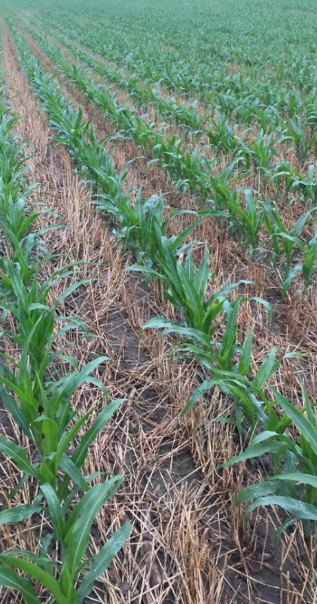
Categories not as easy to quantify
(but important to consider)
Changes in labor (timing)
Soil health characteristics difficult to tie to actual dollars spent or saved
  e.g. earthworms, SOC
Risk
  e.g. increased soil health can help reduce crop loss due to weather extremes
Social Impacts
Notes:
What do you see in these bullets that are tied to our conservation planning (e.g., the CPA-52)?

Slide 13
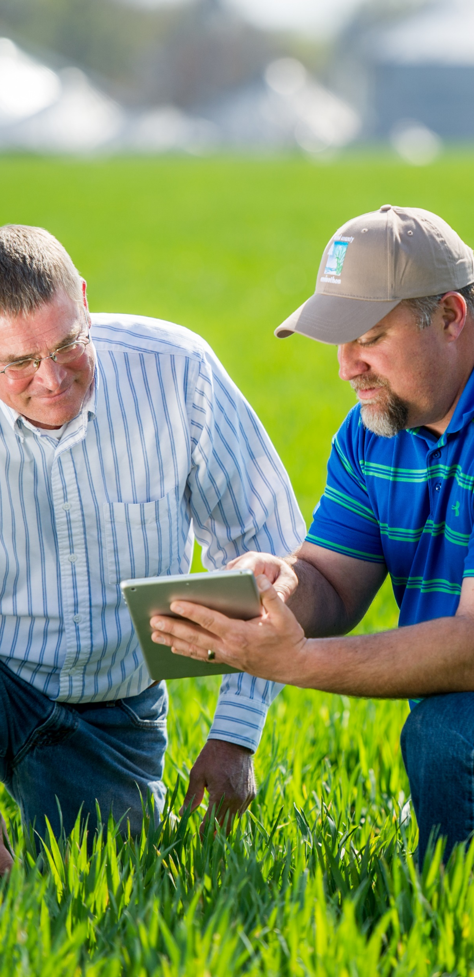
Case Studies
Give real world examples
Usually use partial budget
Good case studies address all aspects of adoption, not just the positive aspects.
Must be relatable.
  Location, climate, crops
  Available resources
Read with a critical eye – ask:
  “Are the benefits applicable to you?
  How about the costs?”
Remsberg, SARE
Notes:
What if a producer chooses to adopt practices that do not enhance or build soil quality? What is the cost? More than likely there will be an erosion issue. Costs of erosion are…read slide.
These are estimates and are conservative in dollar amounts. We know they are higher.
Whole civilizations have collapsed because they have not cared for their soil: W.C. Lowdermilk. 1948. Conquest of the Land Through Seven Thousand Years. USDA Soil Conservation Service.

Slide 14
How do Economists Compare?
Partial Budget Approach
We are looking at WHAT CHANGES – Before and After (or between “Baseline” and “Alternative(s)”)
Positive Effects “+” | Negative Effects “-”
Increased Revenues | Increased Costs
Reduced Costs | Decreased Revenue
Notes:
A partial budget only includes resources that will be changed. It does not consider the resources in the business that are left unchanged. Only the change under consideration is evaluated for its ability to increase or decrease income in the farm business
Looking only at “What Changes” greatly simplifies the data collected and analyzed. We are interested in the direction of the change, does it increase or decrease the producer’s income or expenses? Also, Time Horizon Matters!

Slide 15
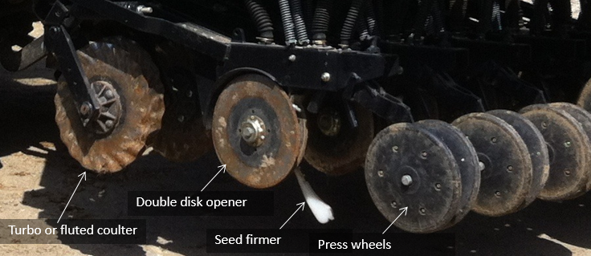
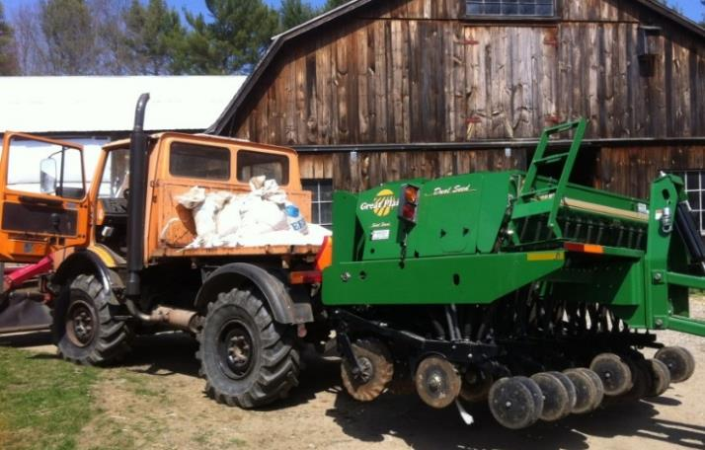
T-Chart Levels & Examples
Level 1 – Descriptive
  (+) Decreased fertilizer use
  (-) No-till drill purchase
Level 2 – Quantitative
  (+) Decreased fertilizer use: 20 lb N/acre
  (-) No-till drill purchase: $25k/drill
*Level 3 – Quantitative + Same Units
  (+) Decreased fertilizer use: $5/ac/yr
  (-) No-till drill purchase: $9/ac/yr amortized at 5 yr loan, 6% interest, 600 acres
Notes:
* This is the level of the case studied from AFT and NRCS – you can use this information when reviewing various case studies to determine at what level the analysis was completed. Studies that are considered “valid economic analysis” would be those using the same units in all comparisons.
Level I takes the positive and negative effects of multiple practices but does NOT add them up! There are synergistic effects as well as impacts from one practice that cannot be multiplied by adding other practices
Level II adds all identifiable costs and returns in whatever terms are available. Many times this may be enough information for a producer to make a decision. However they may need some additional information to justify that high up-front Drill purchase cost. That is when a Level 3 analysis is particularly useful.
Level III converts all those costs and returns in “like” terms taking into account the impact of spreading capital item costs over the life of that item. In this case we are looking at the impact of the change in terms of $/AC/Year.
In this Level 3 analysis we are comparing everything in like terms (“apples to apples”). Isn’t it easier to convince a farmer that an up-front cost of a $25,000 drill spread over the loan period and analyzed per acre it is being used on is really costing them less than $10/ac/year? In this particular case it is a good financial (and economic) decision because benefits outweigh the costs.
When determining a partial budget on your farm, or when looking at a partial budget on another operation, always ask the question “Who is the money going to and who is bearing the cost?” This will lead you to understand who benefits, the farmer or society in general.

Slide 16
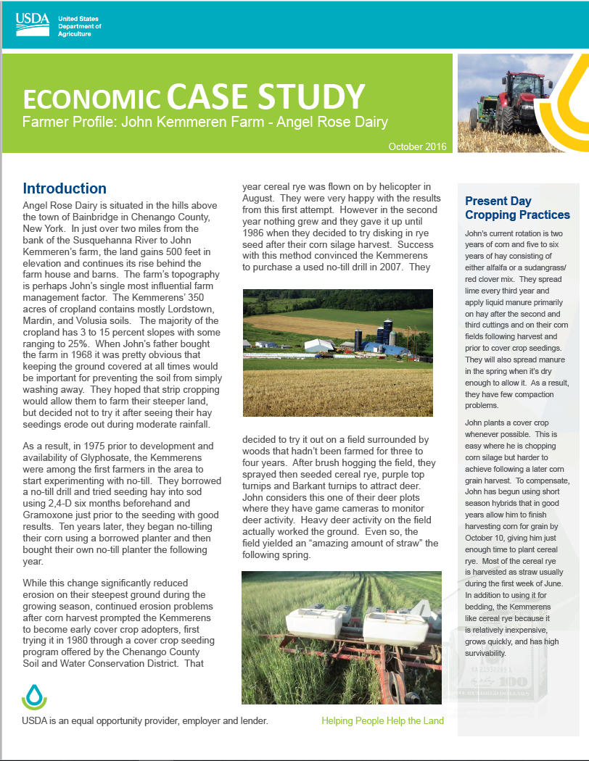
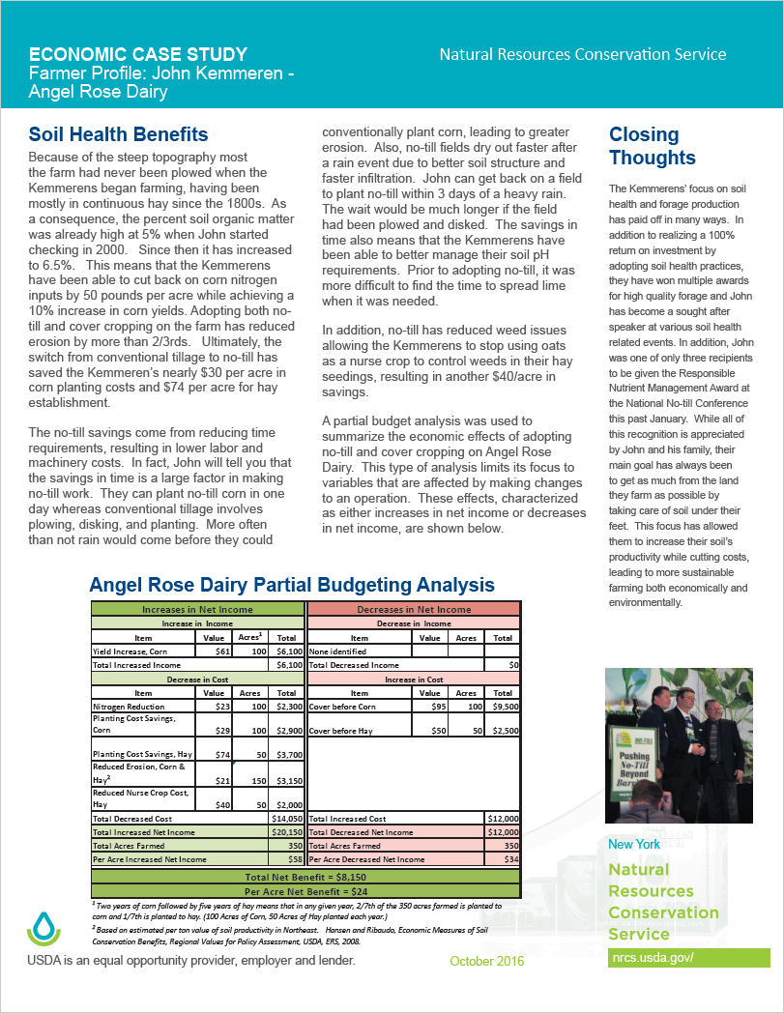
Soil Health Case Study Example
Replace with local case study(s) here. Regional examples can be found in subfolders on Teams under Social and Economic Considerations.
Notes:
This is an example of a soil health case study designed to be easily handed out at field days or other events. It is 2 pages (front and back), formatted to be easy to read and in layman’s terms.
Use an appropriate case study for your region (see economic case studies on SharePoint or look in a State’s eFOTG)

Slide 17
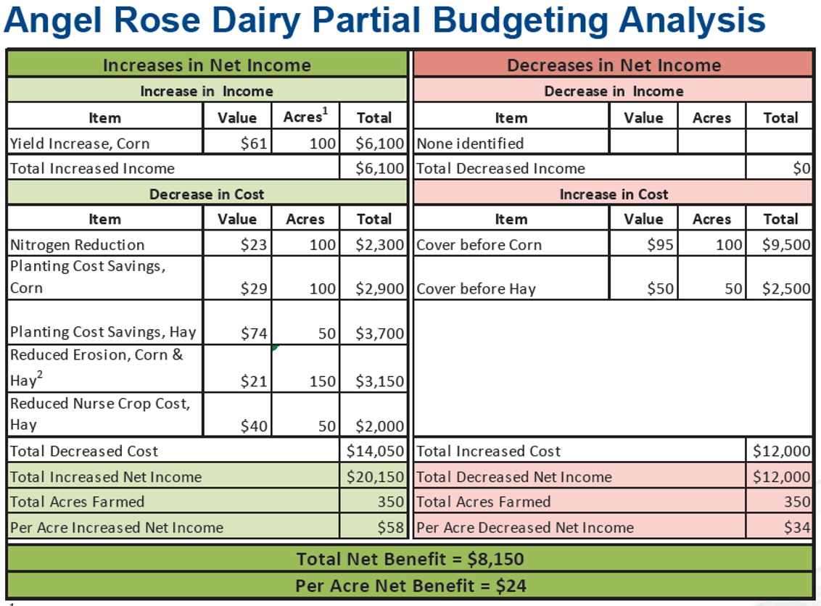
Replace with local case study(s) here. Regional examples can be found in subfolders on Teams under Social and Economic Considerations.
Notes:
The economics are presented in a partial budget format, and then the highlights are discussed within the case study. It is important to note that the partial budget only accounts for WHAT CHANGES from moving from the benchmark condition to implementing the changes in the farming operation.

Slide 18
Things to Remember
Adopting a soil health conservation system is a long-term investment.
Just like soil degradation does not happen over night, improving soil health also takes time.
There are agronomic benefits that result in economic benefits that may not be easily measured, such as reduced risk of yield variability.
To realize the greatest benefits from a SHMS, we must find what works best for a producer given THEIR objectives and goals.

Slide 19
Moving from Awareness to Adoption
Work to develop relationships with producers
Pursue opportunities for producer education
Invite and accompany them to soil health-related events
Invite them to the field and do the assessment together.
Conduct demos at SWCD meetings, equipment auctions, fairs, their farms, etc.
Notes:
This slide and the following are to provide ideas to the students for engaging and encouraging their producers around SH and how transitioning to SHMS might look on their operations.

Slide 20
Moving from Awareness to Adoption (cont.)
Use discussions about erosion on their fields to transition to soil health principles and opportunities
Develop and coordinate an email listserv or social media group of interested producers
Conduct periodic coffee and doughnut meetings around SH topics
What other approaches do you use or think you could use to engage your producers?
Notes:
Encourage class participation in the “What other approaches…” question. They should be able to brainstorm new ideas or share things that they have tried.

Slide 21
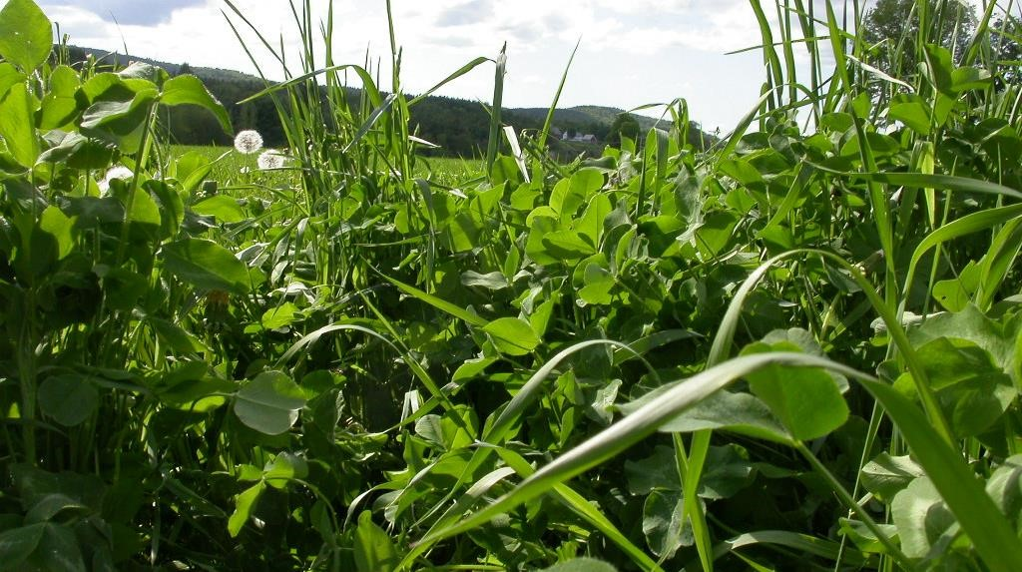
NRCS Economic Resources – Enter “NRCS Economics” in Search Engine
This information is provided as a public service and constitutes no endorsement by the United States Department of Agriculture or the Natural Resources Conservation Service of any service, supply, or equipment listed.
While an effort has been made to provide a complete and accurate listing of services, supplies, and equipment, omissions or other errors may occur and, therefore, other available sources of information should be consulted
The USDA is an equal opportunity provider and employer.
Meeh, NRCS

